Slide 1

MoaYo
고리고리
Copyright ⓒ Slug. All right reserved.

Slide 2
00
도감
도(를 아십니)감?

Slide 3
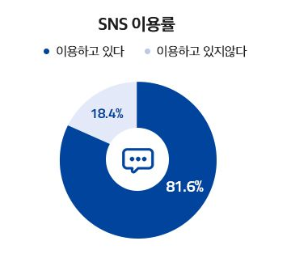
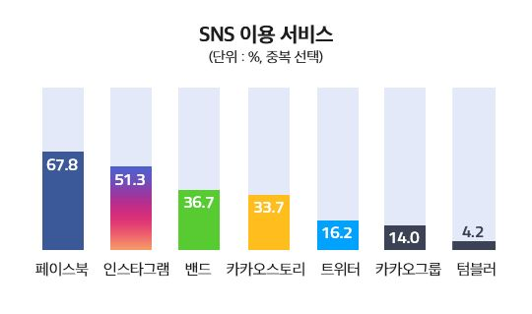
01
Utilization Status of SNS
Copyright ⓒ Slug. All right reserved.

Slide 4
01
Function of Instagram
Copyright ⓒ Slug. All right reserved.

Slide 5
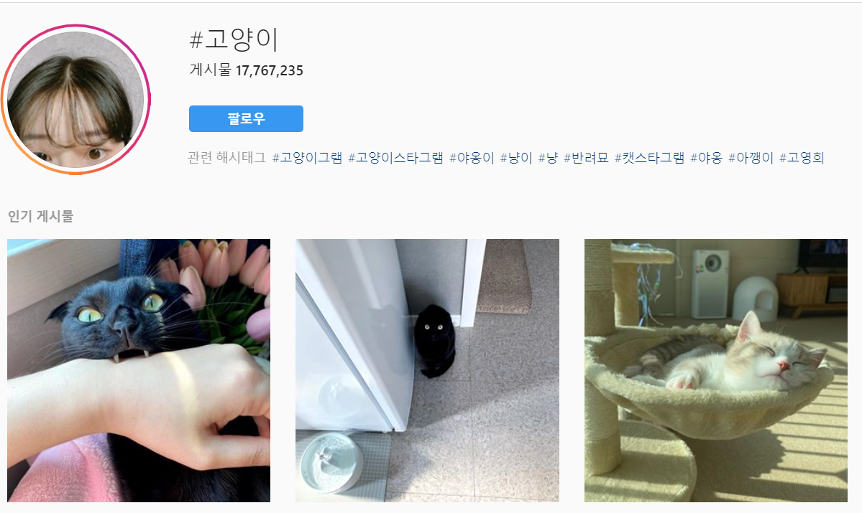
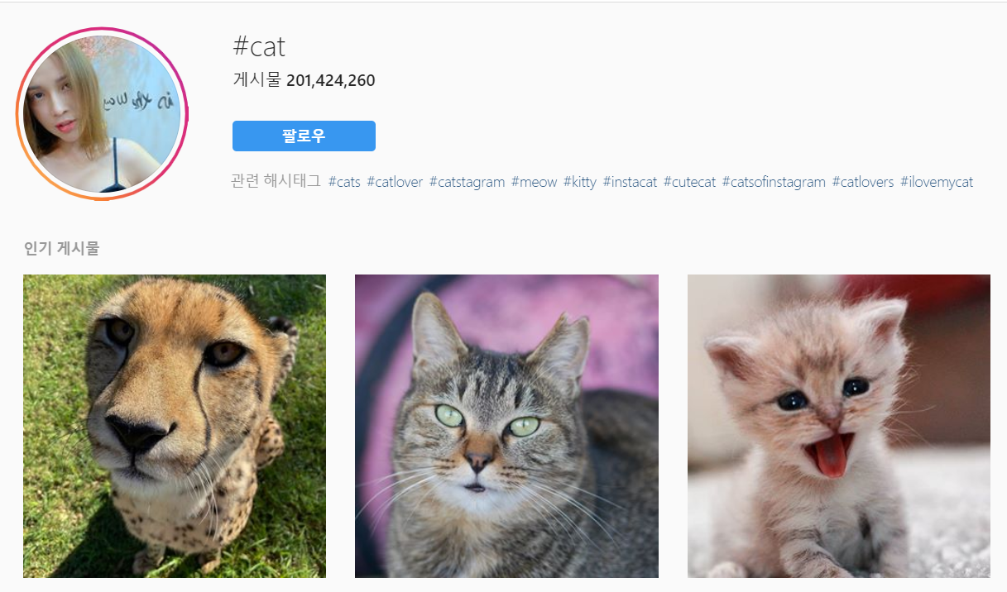
IDOL
BOYGROUP
GIRLGROUP
EXO
BTS
REDVELVET
TWICE
01
≠
Can’t Categorize!
Search tag
Click content
sharing
Same mean! Different result!
Limit of Instagram
Can’t Once!
Copyright ⓒ Slug. All right reserved.

Slide 6
01
Purpose of Instagram

Slide 7
02
MoaYo
내 손안의 도감
인스타그램을 사용하는 사용자들이 게시물들을 저장, 관리함에 있어 계층(Hierarchy)구조를 제공하고, 이렇게 카테고리로 분류된 게시물들을 공유할 수 있는 플랫폼
What is MoaYo?
Copyright ⓒ Slug. All right reserved.

Slide 8
EXO
BTS
REDVELVET
TWICE
IDOL
BOYGROUP
GIRLGROUP
EXO
BTS
REDVELVET
TWICE
03
Can Categorize!
Search tag
Select content
sharing
Search Category
Select Content
Share
Can Once!
Function of MoaYo
gatto
Cat
С
Katze
Gato
고양이
고양이
बिल्ली
ネコ
Chat
kucing
猫
mèo
เจ้าเหมียว
Same mean, Same Result!
Copyright ⓒ Slug. All right reserved.

Slide 9
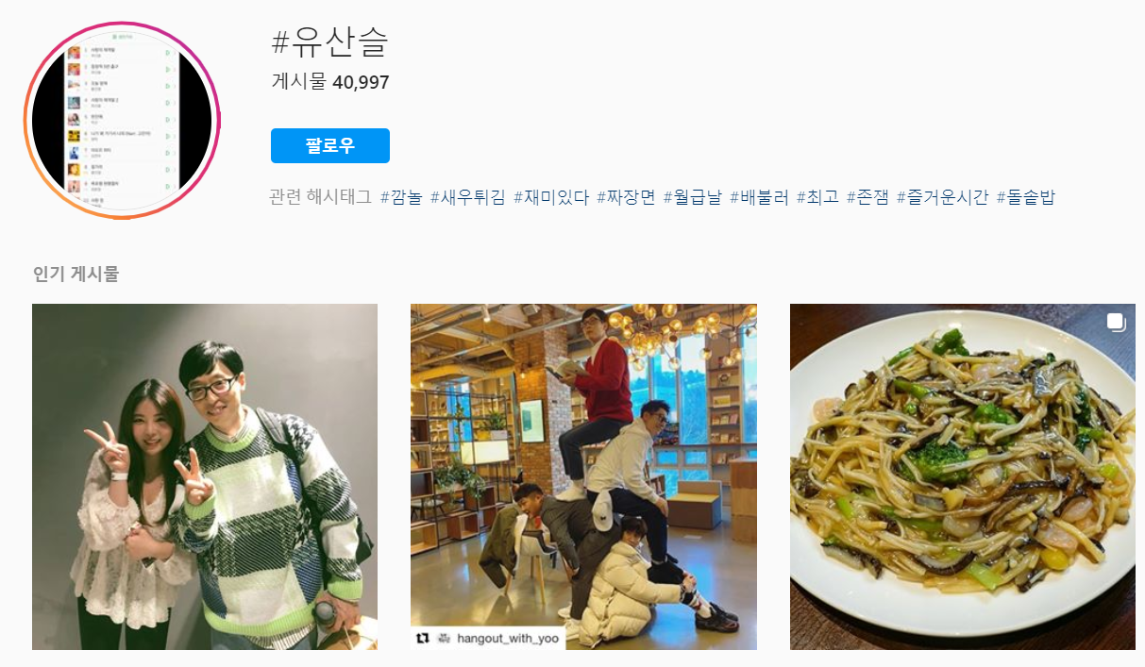
03
MoaYo In Practice
Copyright ⓒ Slug. All right reserved.

Slide 10
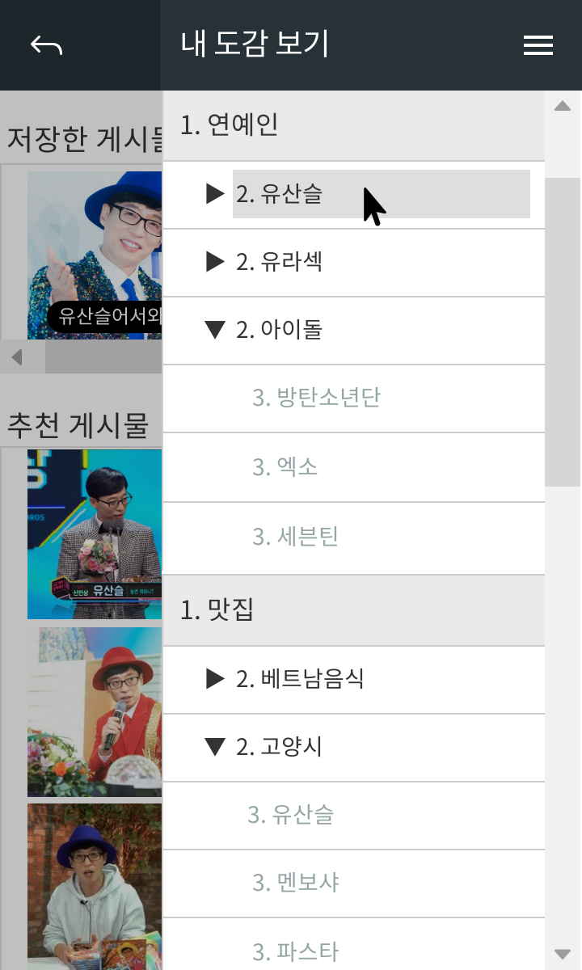
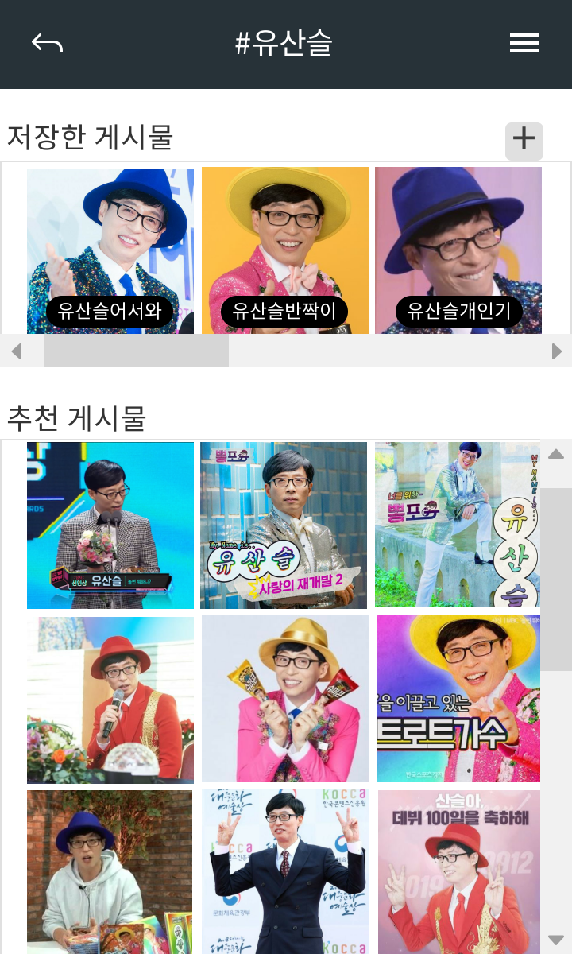
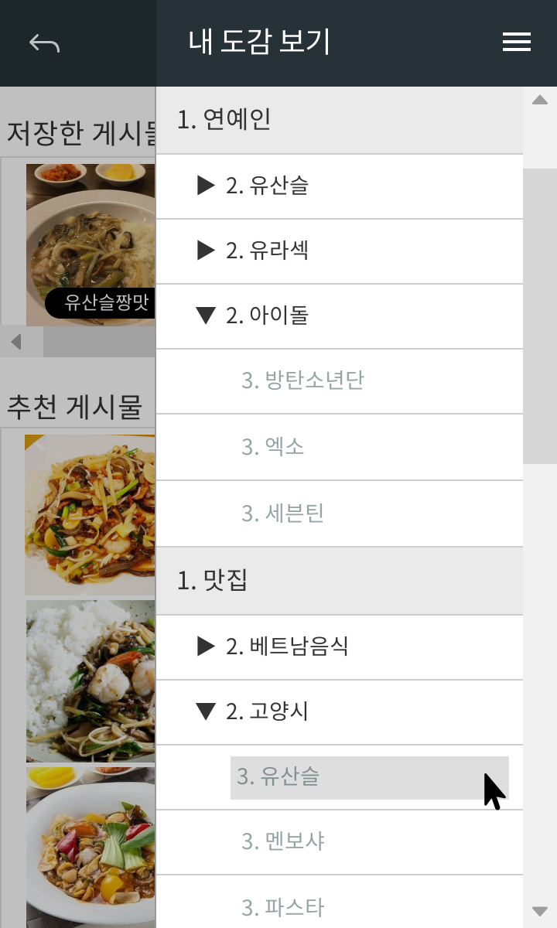
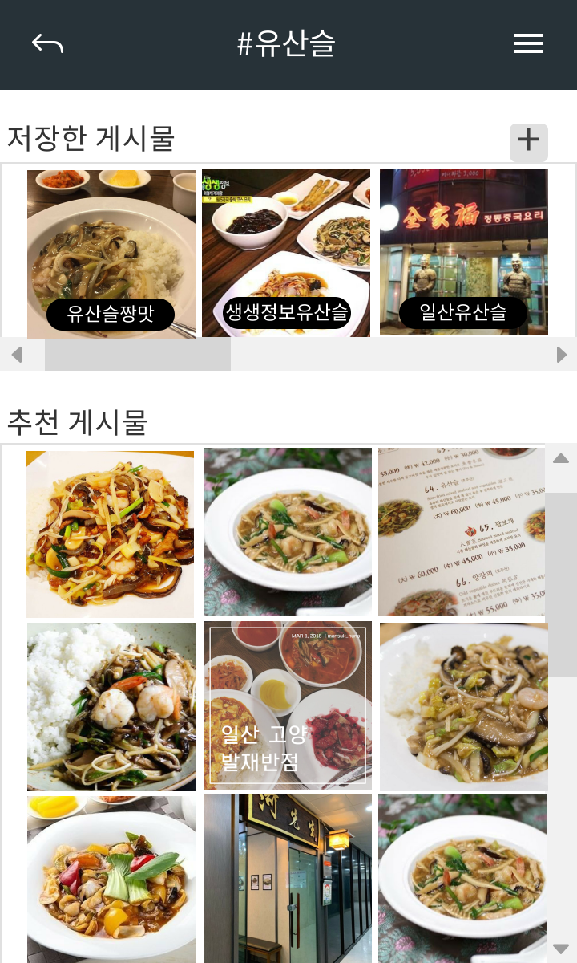
03
MoaYo In Practice
Copyright ⓒ Slug. All right reserved.

Slide 11
04
SNS
도감
MoaYo
SNS with Collection

Slide 12
감사합니다
고리고리
Copyright ⓒ Slug. All right reserved.

